Slide 1
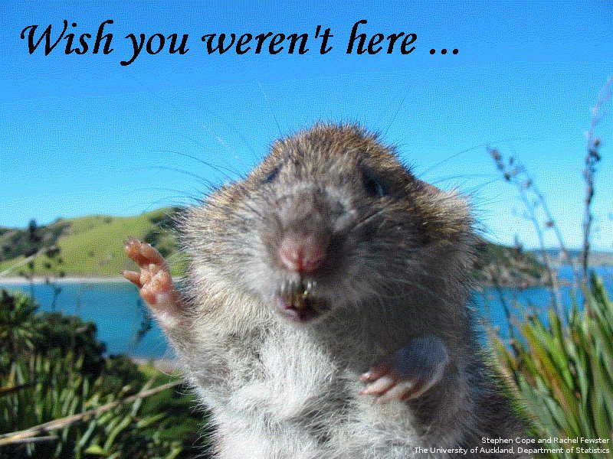
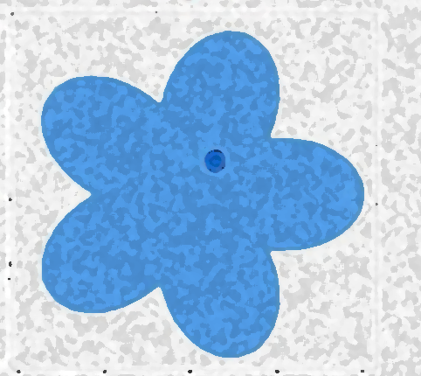
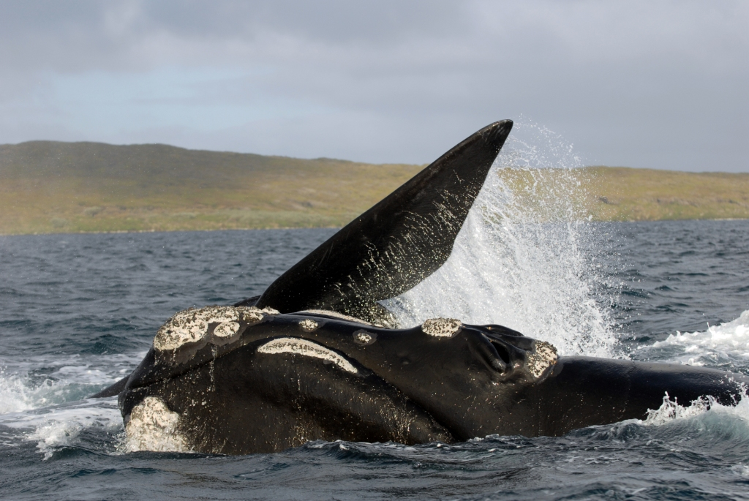

Curiosity killed the rat
– but saved the whale
How a mathematical curiosity is saving NZ’s biodiversity
Rachel Fewster
Department of Statistics

Slide 2
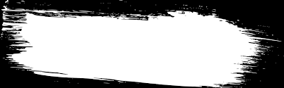

Curiosity killed the rat
– but saved the whale
How a mathematical curiosity is saving NZ’s biodiversity
The story of an idea
that didn’t change the world
at first
Rachel Fewster
Department of Statistics

Slide 3
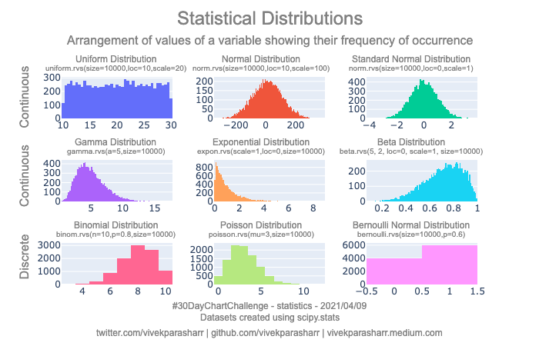
Statistics is about understanding the world through probability models

Slide 4



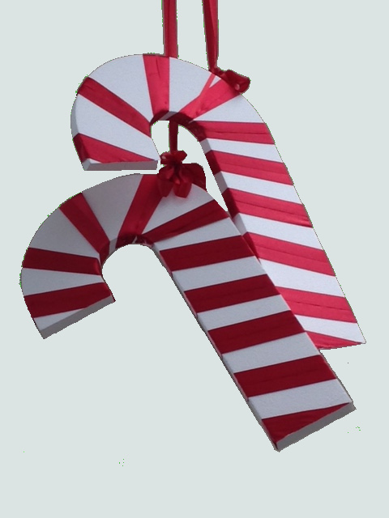
Statisticians love probability models!
Only 24 days till Christmas!!

Slide 5
Meet the data not of your dreams
What if we can’t observe the things we want to model?
What we want to model
What we actually observe
Info for each animal:
1 0 1 0 0 1 0
2 1 0 0 0 0 0
3 0 0 0 0 1 1
: :

Slide 6
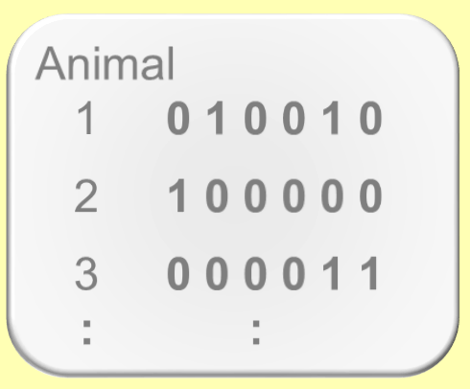
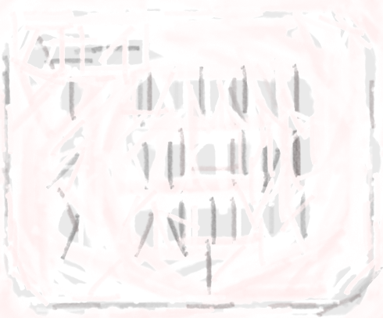
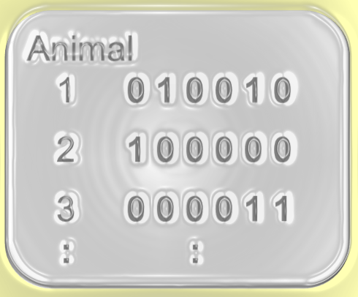
Meet the data not of your dreams
What if we can’t observe the things we want to model?
What we want to model
What we actually observe
Info for each animal:
1 0 1 0 0 1 0
2 1 0 0 0 0 0
3 0 0 0 0 1 1
: :
Irreversible
transformation of the data we wanted

Slide 7
Meet the data not of your dreams
What if we can’t observe the things we want to model?
We know how to model this…
… but how are we supposed to model this?
Info for each animal:
1 0 1 0 0 1 0
2 1 0 0 0 0 0
3 0 0 0 0 1 1
: :

Slide 8


How many stoats are at large?
Sensor Network

Slide 9
How many stoats are at large?
Sensor Network
We can model these…
Each stoat generates detections at sensors…

Slide 10
But our data are sensor-based, not animal-based
x₁
x₂
x₃
x₄
x₅
x₆
x₇
x₈
Data from each animal is split among sensors
Data at each sensor combines multiple animals
x₉
x₁₀
x₁₁
x₁₂

Slide 11
What we observe…
x₁
x₂
x₃
x₄
y₆
y₁
y₂
y₅
y₃
y₄
y₇
y₈
x₅
x₆
x₇
x₈
y₉
y₁₀
y₁₁
y₁₂
x₉
x₁₀
x₁₁
x₁₂
…is an irreversible transformation of what we can model

Slide 12
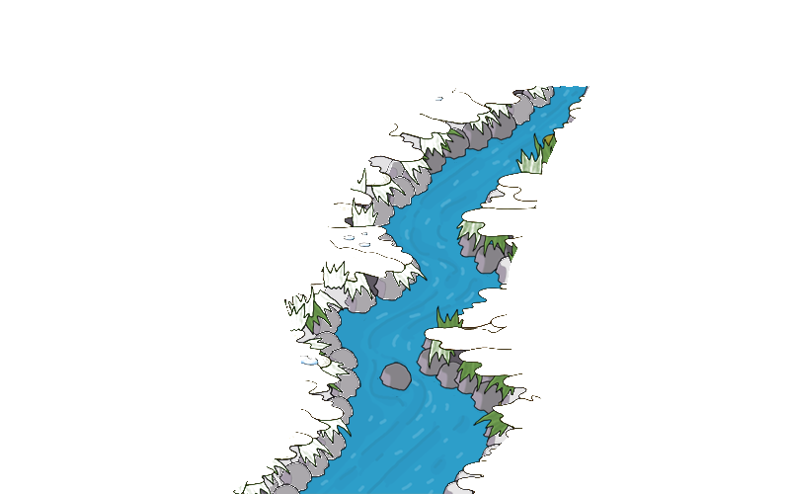



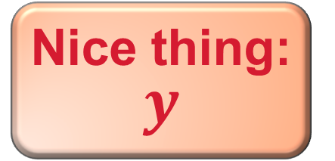
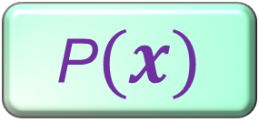
What we
can model
What we
can observe
Nice thing: $y$
Needed thing$:$
$$x$$
P$(x)$

Slide 13
What we observe…
x₁
x₂
x₃
x₄
y₆
y₁
y₂
y₅
y₃
y₄
y₇
y₈
x₅
x₆
x₇
x₈
y₉
y₁₀
y₁₁
y₁₂
x₉
x₁₁
x₁₂
linear
^
…is an irreversible transformation of what we can model

Slide 14
What we observe…
Remember how it’s really hard to find the probability of a sum of r.v.s…
x₁
x₂
x₃
y₁
y₂
y₃
y₄
x₅
x₆
… but really easy to find the moment generating function?
y₉
y₁₀
y₁₁
y₁₂
x₉
x₁₂
linear
^
…is an irreversible transformation of what we can model

Slide 15
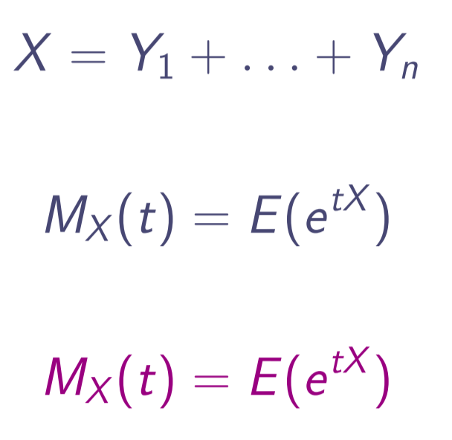
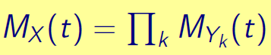
Remember how it’s really hard to find the probability of a sum of r.v.s…
… but really easy to find the moment generating function?
linear
^
…is an irreversible transformation of what we can model

Slide 16

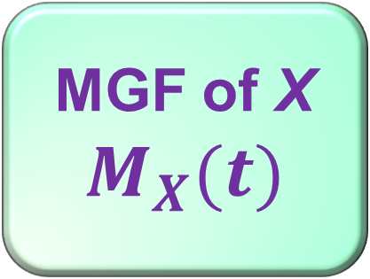
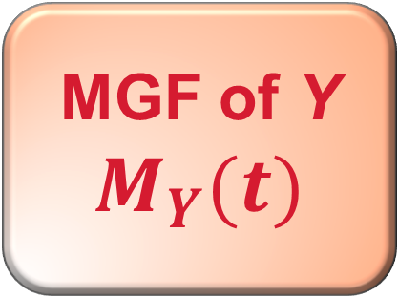
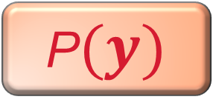

What we
can model
What we
can observe
Nice thing: $y$
Needed thing$:$
$$x$$
P$(y)$
P$(x)$
MGF of Y
$$M_{Y}(t)$$
MGF of X
$$M_{X}(t)$$

Slide 17
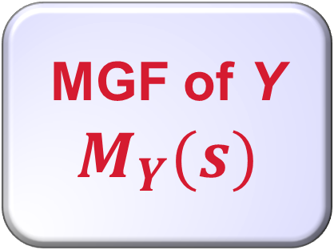
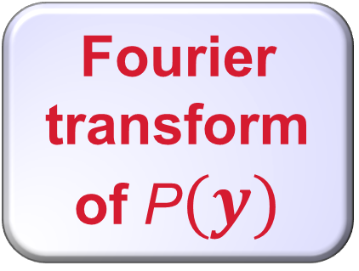
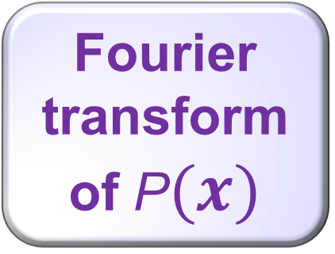
What we
can model
What we
can observe
Nice thing: $y$
Needed thing$:$
$$x$$
P$(y)$
P$(x)$
Fourier transform of P$(y)$
Fourier transform of P$(x)$

Slide 18
What we
can model
What we
can observe
Nice thing: $y$
Needed thing$:$
$$x$$
P$(y)$
P$(x)$
??
MGF of Y
$$M_{Y}(t)$$
MGF of X
$$M_{X}(t)$$

Slide 19

What we
can model
What we
can observe
Nice thing: $y$
Needed thing$:$
$$x$$
P$(y)$
P$(x)$
??
MGF of Y
$$M_{Y}(t)$$
MGF of X
$$M_{X}(t)$$

Slide 20

What we
can model
What we
can observe
Nice thing: $y$
Needed thing$:$
$$x$$
P$(y)$
P$(x)$
MGF of Y
$$M_{Y}(t)$$
MGF of X
$$M_{X}(t)$$

Slide 21


Nice thing: $y$
Needed thing$:$
$$x$$
P$(x)$
P$(y)$
MGF of Y
$$M_{Y}(t)$$
MGF of X
$$M_{X}(t)$$

Slide 22


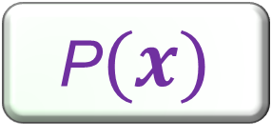
P$(x)$

Slide 23
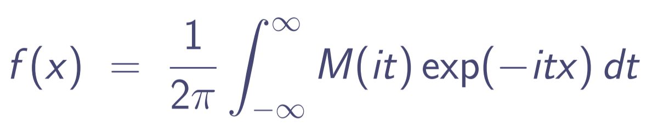
Why do we need a balloon?
The inversion integral for the MGF is an unfriendly beast:
What we want
What we have
Easy as π …?
Integrate “something” along the imaginary axis

Slide 24
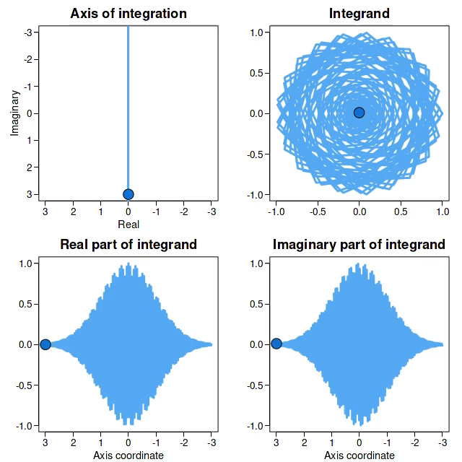

Notes:
This is the integral for f_X(x) where X~N(0, 1) and x=100 (not a very likely observation!) using the imaginary axis with no offset (i.e. tau=0). So mu=0, x=100, tau=0.

Slide 25
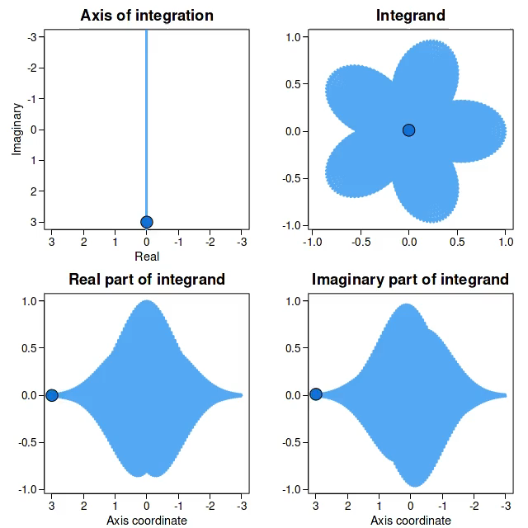
This is just an easy case!
Univariate integrand;
target is Normal distribution
Notes:
This one is for f_X(x) where X~N(100, 1) and x=(-110) : again not a very likely observation! Again using the imaginary axis with no offset (i.e. tau=0). So mu=100, x=(-110), tau=0.
Code for the Normal plot: (then copy as metafile and paste straight into powerpoint):
colo <- "purple"
xvals <- seq(-4, 4, 0.001)
plot(xvals, dnorm(xvals, 0, 1), lwd=8, col=colo, yaxt="n", bty="n", xlab="", ylab="", type="l", xaxt="n")
axis(1, lwd=5, at=c(-20, 20), col=colo)

Slide 26




Nice thing: $y$
Needed thing$:$
$$x$$
P$(y)$
P$(x)$
MGF of Y
$$M_{Y}(t)$$
MGF of X
$$M_{X}(t)$$

Slide 27

A Curiosity …
… but not a practical tool.
Needed thing$:$
$$x$$
P$(x)$
MGF of Y
$$M_{Y}(t)$$
MGF of X
$$M_{X}(t)$$
Not so fast…

Slide 28
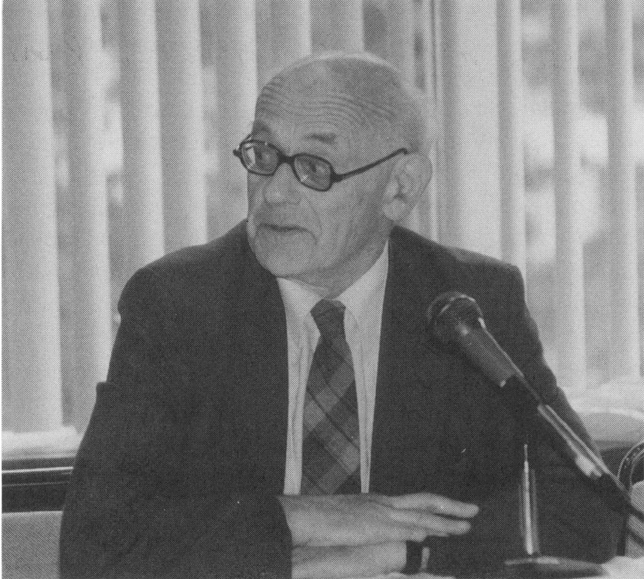
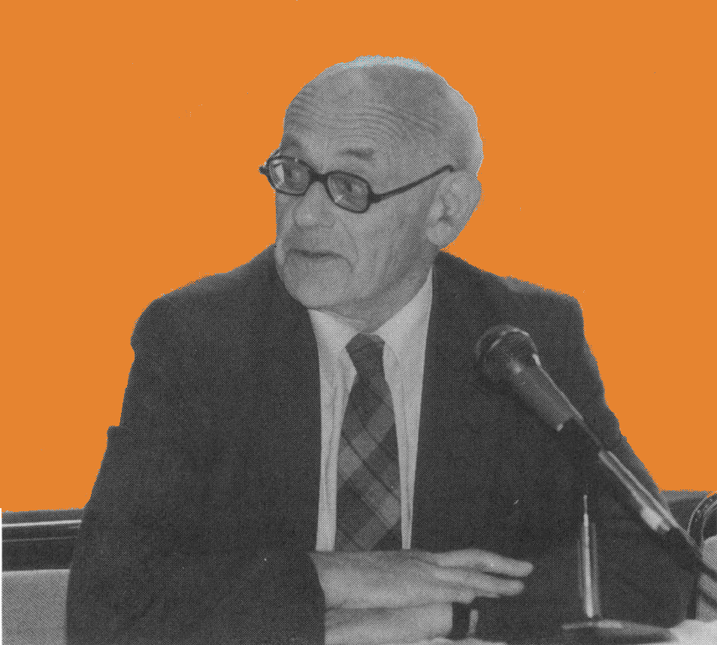

Henry Daniels
1954
Saddlepointconverts an MGF into a PDF
Introduced the
saddlepoint approximation
to statistics

Slide 29

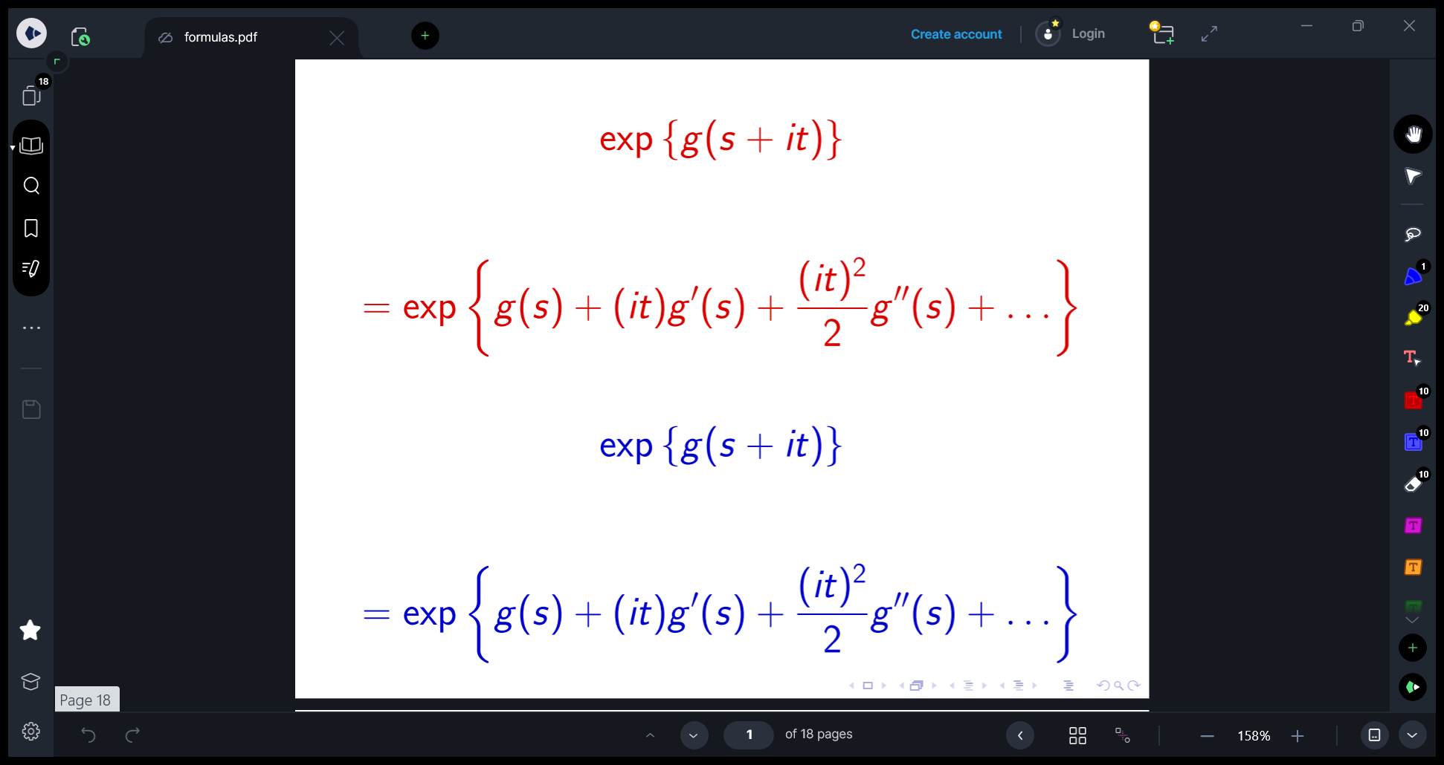

How does the saddlepoint method work?
i) Write the integrand as exp(something);
ii) Taylor-expand the “something” about a saddlepoint chosen to kill the linear term
Killing the linear term cuts out the pesky oscillation:
cos(t) + i sin(t)
Notes:
The saddlepoint:
Maximizes real part of log-integrand through vertical axis
Minimizes it through horizontal axis (this is a complex analysis thing)

Slide 30
How does the saddlepoint method work?

Slide 31
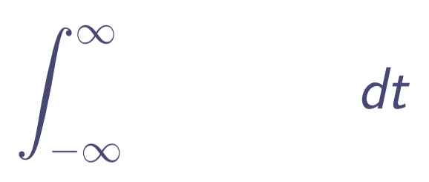
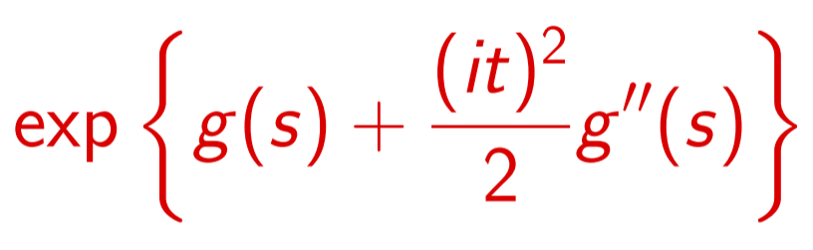
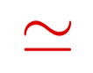
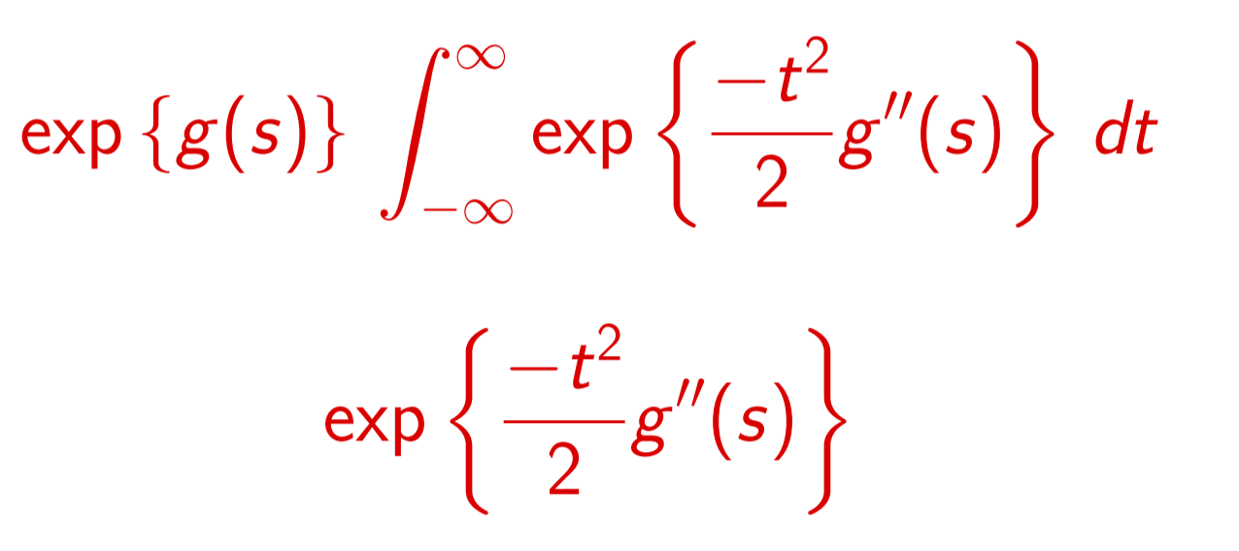
How does the saddlepoint method work?
Gaussian integral!

Slide 32
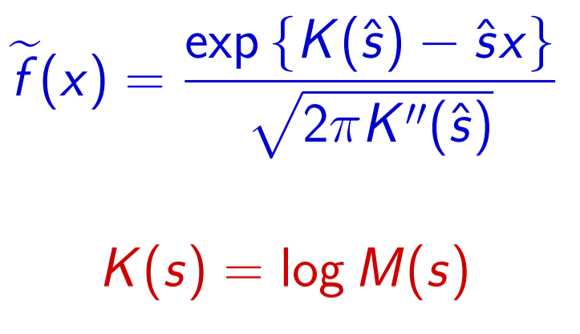
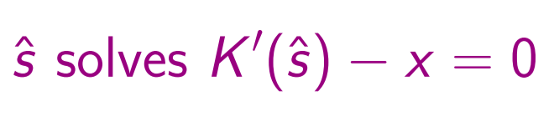
How does the saddlepoint method work?
Saddlepoint PDF is Gaussian integral:
PDF
log (MGF)
Saddlepoint

Slide 33


Nice thing: $y$
Needed thing$:$
$$x$$
P$(y)$
P$(x)$
MGF of Y
$$M_{Y}(t)$$
MGF of X
$$M_{X}(\hat{s})$$

Slide 34
Nice thing: $y$
Needed thing$:$
$$x$$
P$(y)$
P$(x)$
MGF of Y
$$M_{Y}(t)$$
MGF of X
$$M_{X}(\hat{s})$$

Slide 35

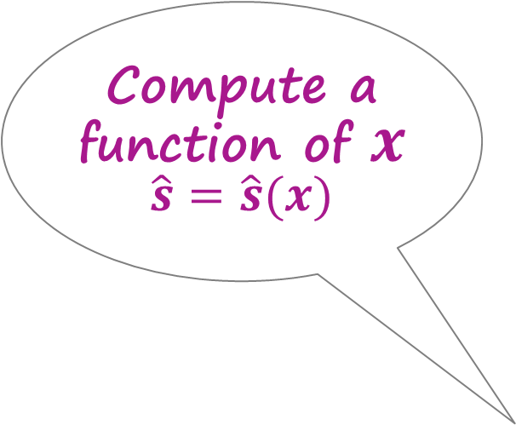
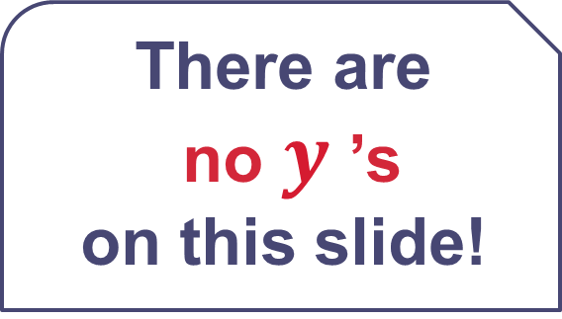
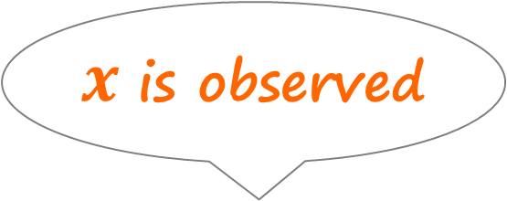
There are
no $y$’s
on this slide!
Needed thing$:$
$$x$$
Compute a function of $x$ $\hat{s}=\hat{s}(x)$
P$(x)$
$x$ is observed
MGF of X
$$M_{X}(\hat{s})$$

Slide 36
Meet the data not of your dreams
We know how to model this…
... without ever needing this!
Now we’ve figured out how to model this…
Info for each animal:
1 0 1 0 0 1 0
2 1 0 0 0 0 0
3 0 0 0 0 1 1
: :

Slide 37
What you don’t see …
… doesn’t do you any harm!
x₁
x₂
x₃
x₄
y₆
y₁
y₂
y₅
y₃
y₄
y₇
y₈
x₅
x₆
x₇
x₈
y₉
y₁₀
y₁₁
y₁₂
x₉
x₁₀
x₁₁
x₁₂

Slide 38
What you don’t see …
We can directly find the probability of the data…
… doesn’t do you any harm!
x₁
x₂
x₃
x₄
… even though it’s a horrible convolution!
x₅
x₆
x₇
x₈
x₉
x₁₀
x₁₁
x₁₂

Slide 39
So this would have been a big hit, right…?
Daniels 1954
Nothing!
for 24 years
Now about 15 papers per year

Slide 40
Compared with MCMC
introduced from Physics in the 1990s

Slide 41
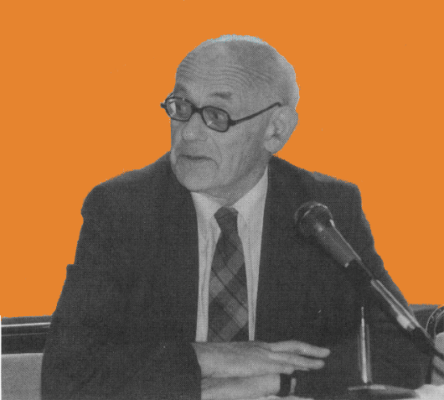
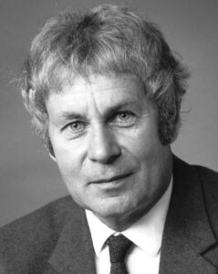
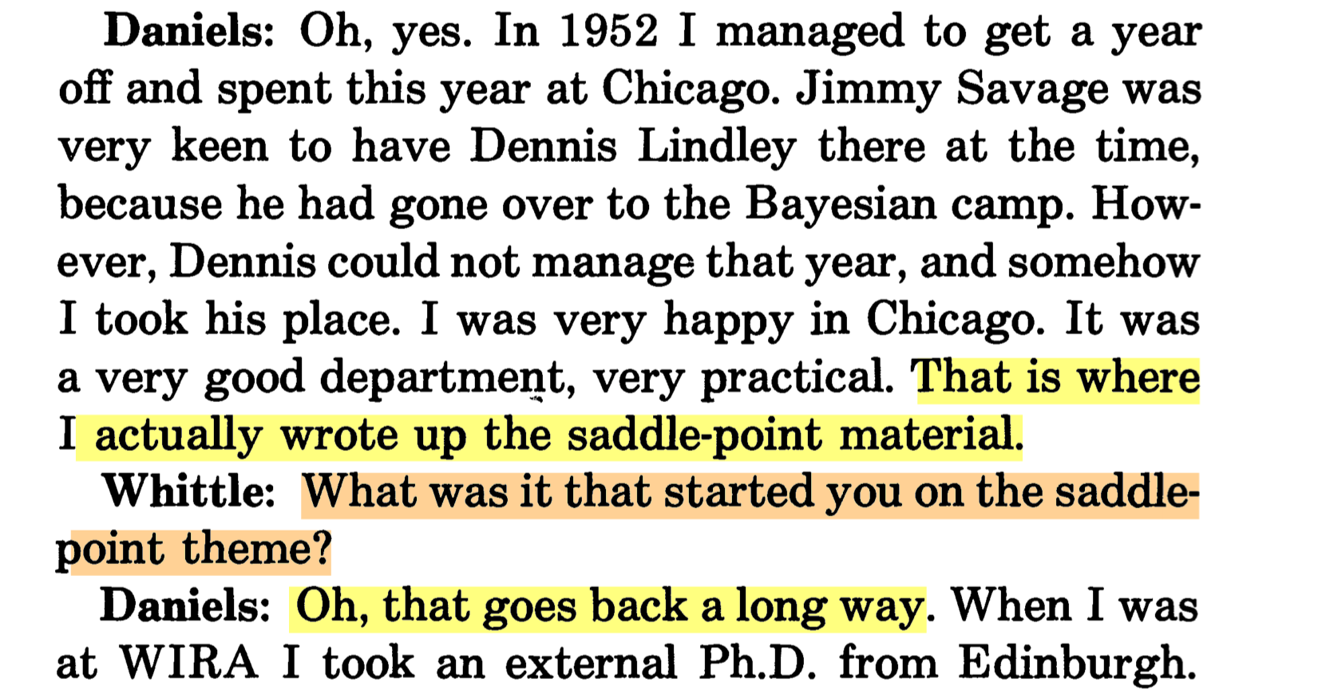
It’s not that people weren’t interested…
Henry Daniels FRS
President RSS
Guy Medal in Gold
Interview with
Peter Whittle
FRS FRSNZ
Statistical Science 1993

Slide 42
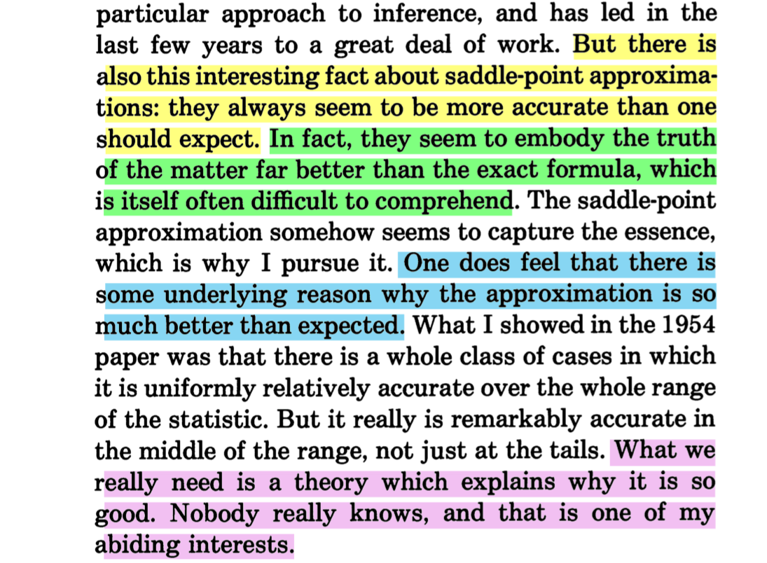

… And it’s not that the approximation isn’t accurate

Slide 43


The accuracy is astonishing!
Richard Vale inadvertantly derived an
exact solution
for one specific model
Richard Vale
Joey Zhang (PhD UoA) implemented the
saddlepoint approximation
for the same model …
Joey Wei Zhang

Slide 44
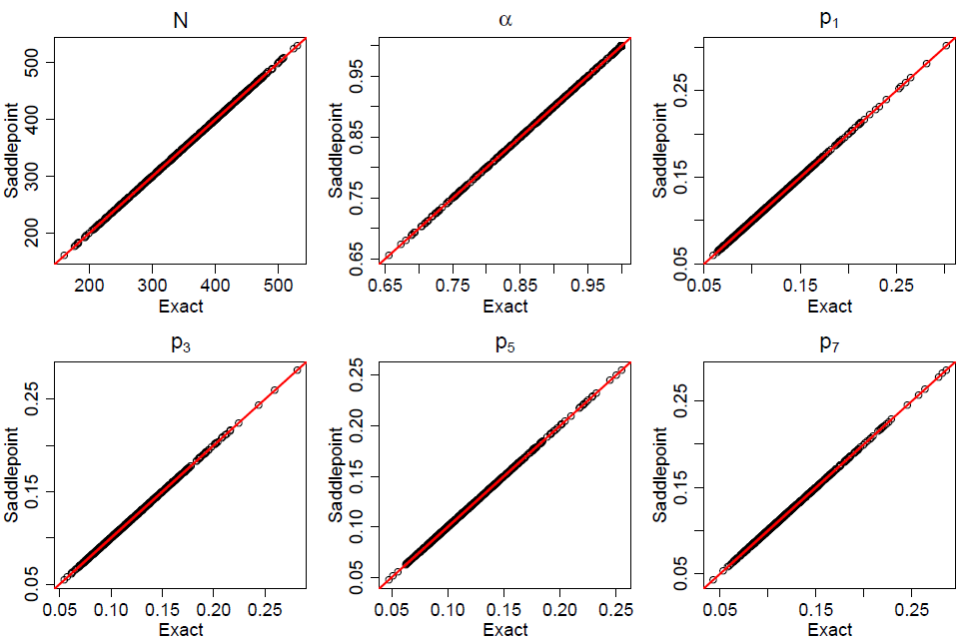
The accuracy is astonishing!

Slide 45

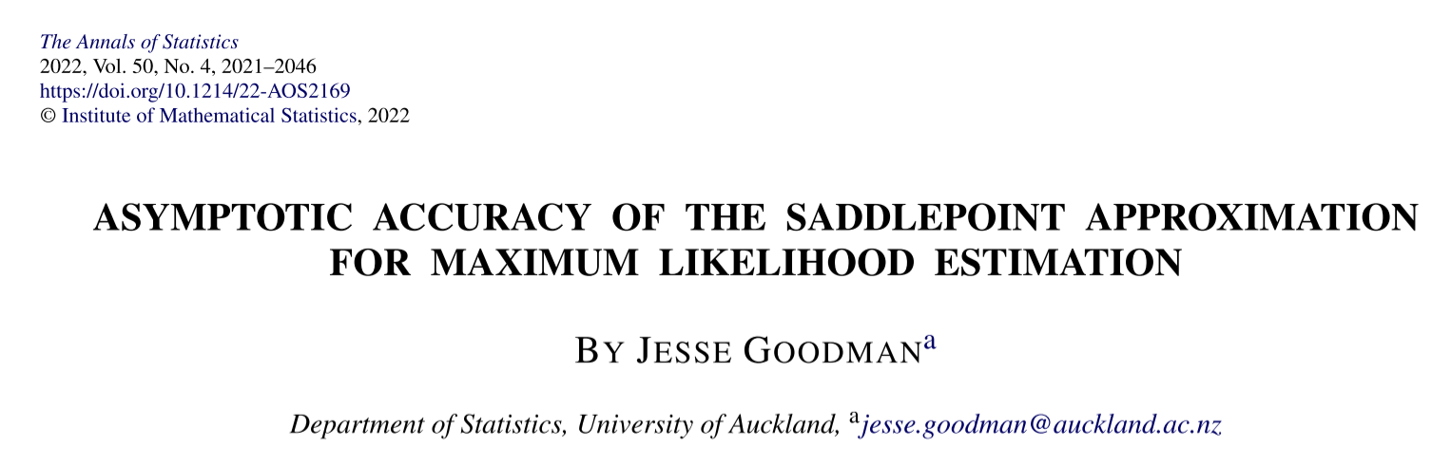



A theory to explain why it’s so good…?
Jesse Goodman: Annals of Statistics, 2022
Jesse’s is the first analysis of the approximation error in an estimation context
He showed the estimates are more accurate than the probability distribution on which they’re based!

Slide 46
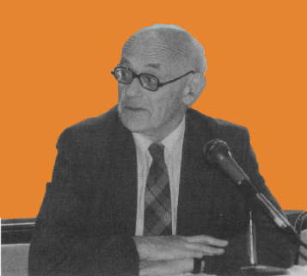
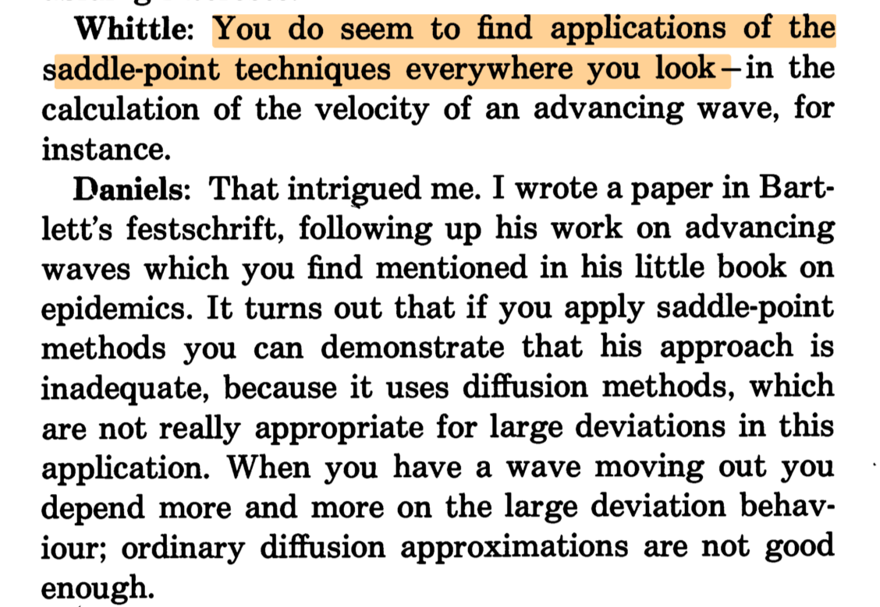
It’s not even that there are no applications…
Henry Daniels
Interview with
Peter Whittle
1993

Slide 47
Maybe it’s just … unfamiliar?
Random preprint, 2023:
We are also aware of the saddlepoint approximation as an alternative …
However, we suspect that this method won’t work
(I’m paraphrasing)
Perhaps a bit intimidating?
Notes:
Quote from: Haplotype frequency inference from pooled genetic data with a latent multinomial model
Yong See Foo and Jennifer A. Flegg. arXiv:2308.16465v1 (2023)

Slide 48
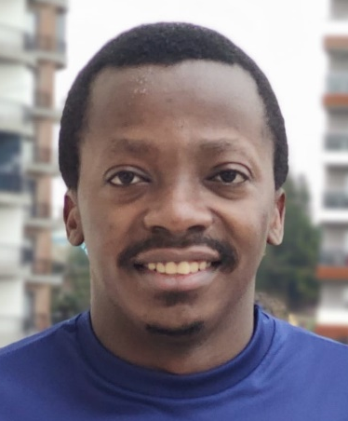
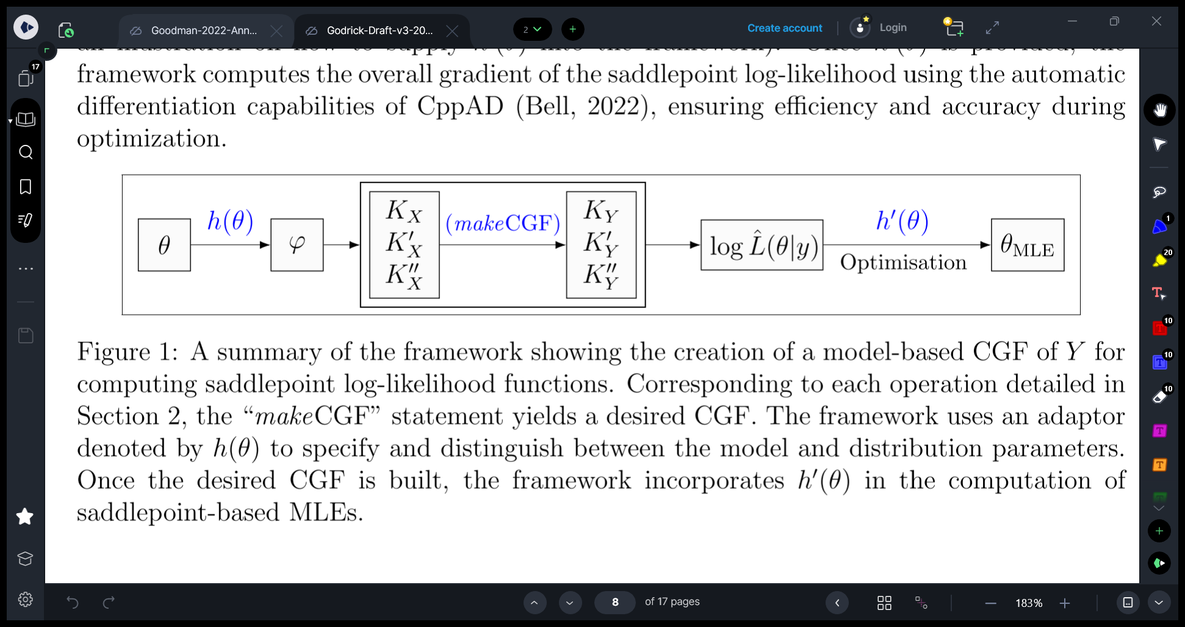

Maybe it’s just … unfamiliar?
Godrick’s software will take care of it!
Godrick Oketch (nearly-PhD):
a computational framework for automatic saddlepoint magic
Perhaps a bit intimidating?

Slide 49
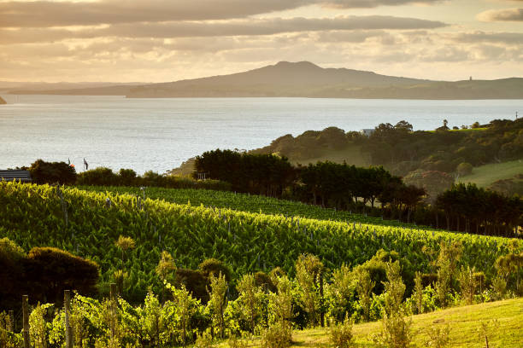
The Hauraki Gulf is home to…
So what did all this have to do with Ecology 3 again…?

Slide 50
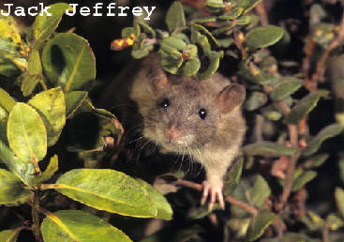
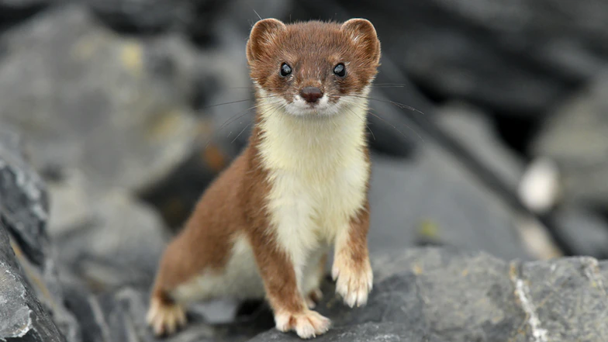

Keeping island sanctuaries
free from invaders
New Zealand’s MOST WANTED
CV and Notable Skills
Eating natives
Breeding
Swimming

Slide 51
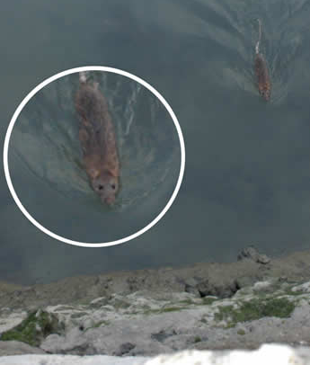

Slide 52



Keeping island sanctuaries free from invaders
When rats or stoats turn up on a sanctuary island…
…we can tell where they came from using genetic analysis
A balance of probabilities of numerous different traits

Slide 53



Could these gentlemen have come from Germany?
Eye colour | Hair colour | Blood type | Knee shape | … | Overall
H | H | L | M | … | H
M | M | H | L | … | L
We can find P$(y_{i})$ for each $i$ …
But what we need is overall P$(x)$
where ${x=y_{1}+y_{2}+…+y}_{k}$
Inspect multiple genetic traits:
$y_{i}$ = fit to Germany of trait $i$

Slide 54
Could these gentlemen have come from Germany?
Eye colour | Hair colour | Blood type | Knee shape | … | Overall
H | H | L | M | … | H
M | M | H | L | … | L
We can find P$(y_{i})$ for each $i$ …
But what we need is overall P$(x)$
where ${x=y_{1}+y_{2}+…+y}_{k}$
Never fear, saddlepoint is here!
Oh no, it’s a convolution...

Slide 55

GenePlot
Made in New Zealand from locally-sourced saddlepoints
Overall genetic fit to Italy
Overall genetic fit to Germany

Slide 56


Saddlepoint means we can calculate distribution of overall genetic fit in each source population
Louise McMillan
PhD UoA

Slide 57

Unfolding disaster on Resolution Island, Fiordland
Saddlepoint-guided conservation management
Photo: Stuff
5th largest island in NZ – premium conservation land
The rats seem to be invading from across the channel
Notes:
Picture across Acheron Passage from Mt Clerke on Resolution Island: from https://www.stuff.co.nz/environment/98520099/peregrine-wines-helping-eliminate-stoats-from-fiordlands-resolution-island
I suspect the arrows are actually pointing across Wet Jacket Arm from North to South peninsula, rather than from mainland to Resolution Is; however the channel size and format is very similar so it’s probably the best view to give.

Slide 58


So curiosity really did kill the rat!
What about saving the whale…?

Slide 59
So curiosity really did kill the rat!
What about saving the whale…?
Monitoring wildlife populations
the up-close-and-personal way
Subantarctic Auckland Islands in winter
Cold people with cameras
Tohorā / Southern right whale

Slide 60

Photos identify individual whales

Slide 61


Surveys are expensive!
Use two identification methods…
Photos
DNA samples
Problem: can’t match a photo
to a DNA sample
But photos are only half the story…

Slide 62





Animal count
Fragment count
Observed fragments
True encounter histories
P
0
D
P | 0 | 0
0 | 0 | D
0 | P | 0
x₁
y₁
x₂
0
P
D
y₂
x₃
...
…
…
…
…
…
Saddlepoint to the rescue again…

Slide 63

And the answer is…
1996 | ~ 500
2009 | ~ 1000
2022 | ???
UoA Southern Right Whale/Tohorā Research Team 2020
NZ Geographic  Photos taken under permit from DoC

Slide 64


And the answer is…
2000 ?
≅ 6% increase per year
1996 | ~ 500
2009 | ~ 1000
2022 | ???
UoA Southern Right Whale/Tohorā Research Team 2020
NZ Geographic  Photos taken under permit from DoC
Notes:
Going up at about 6% per year, which is exactly the same trajectory as Auckland house-prices over the same period. But still well below the 30,000 pre-whaling numbers.

Slide 65


Saddlepoint … coming soon to a wildlife population near you
Left/right photos from camera traps

Slide 66


Thank you!
!

Slide 68



Suppose we want the probability density at 3:
f (3) when X ~ Normal(0,1)
Cauchy’s Residue Thm: the integration axis doesn’t matter!
Notes:
Code for Normal curve: Cairo("NormalPDF.png", width=500, height=350, pointsize=14)
NormalCurve.func()
dev.off()

Slide 69

Suppose we want the probability density at 3:
f (3) when X ~ Normal(0,1)
Cauchy’s Residue Thm: the integration axis doesn’t matter!

Slide 70

Suppose we want the probability density at 3:
f (3) when X ~ Normal(0,1)
Cauchy’s Residue Thm: the integration axis doesn’t matter!
Every axis gives the same answer …
... but some axes give it more politely!

Slide 71

Is there a BEST axis?
Imaginary
Real

Slide 72

Quest for the Best
Seeking f (3) for X ~ Normal(0,1)
Saddlepoint
s=3
One glorious choice of axis makes the integrand simpler than any other
Notes:
Info here: https://galileo.phys.virginia.edu/classes/751.mf1i.fall02/ComplexVariable.htm

Slide 73

The saddlepoint:
Maximizes real part of log-integrand through vertical axis
Minimizes it through horizontal axis (just a complex analysis thing)
The zero first derivative cuts out that pesky oscillation
Notes:
Info here: https://galileo.phys.virginia.edu/classes/751.mf1i.fall02/ComplexVariable.htm

Slide 74
The saddlepoint:
Maximizes real part of log-integrand through vertical axis
Minimizes it through horizontal axis (just a complex analysis thing)
The zero first derivative cuts out that pesky oscillation
cos(t) + i sin(t)
Notes:
Info here: https://galileo.phys.virginia.edu/classes/751.mf1i.fall02/ComplexVariable.htm

